Slide 1
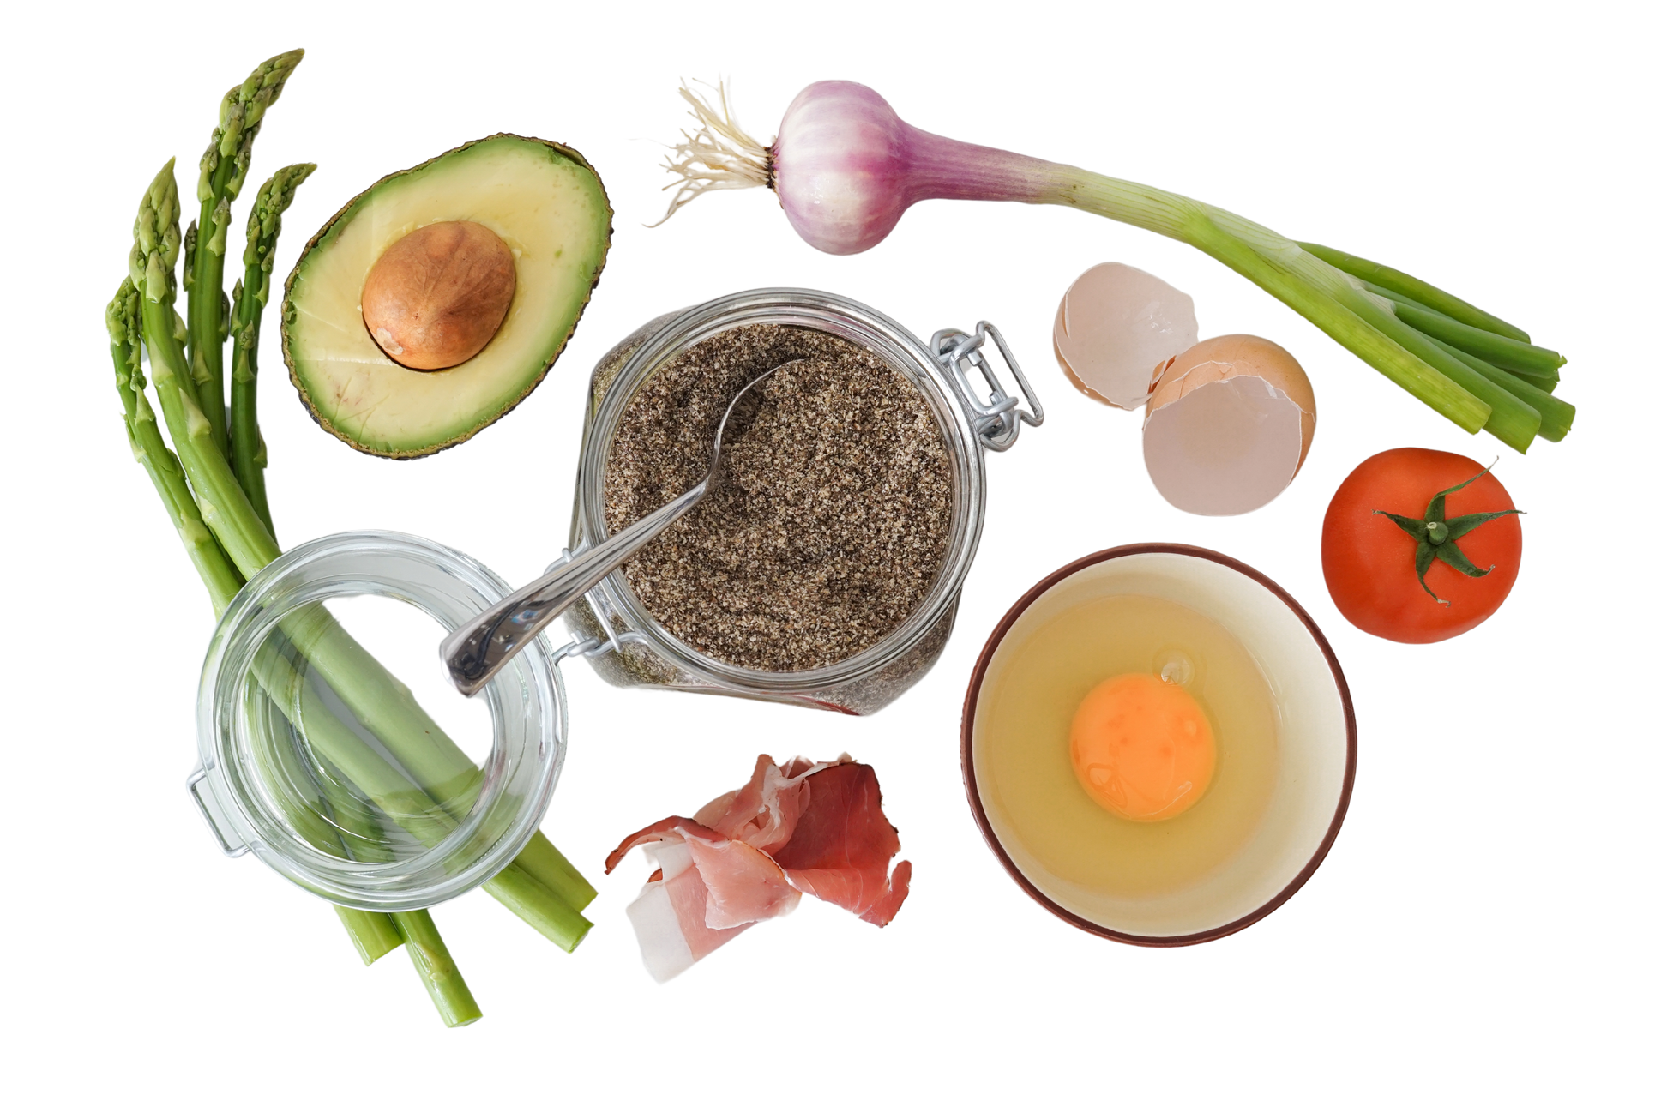


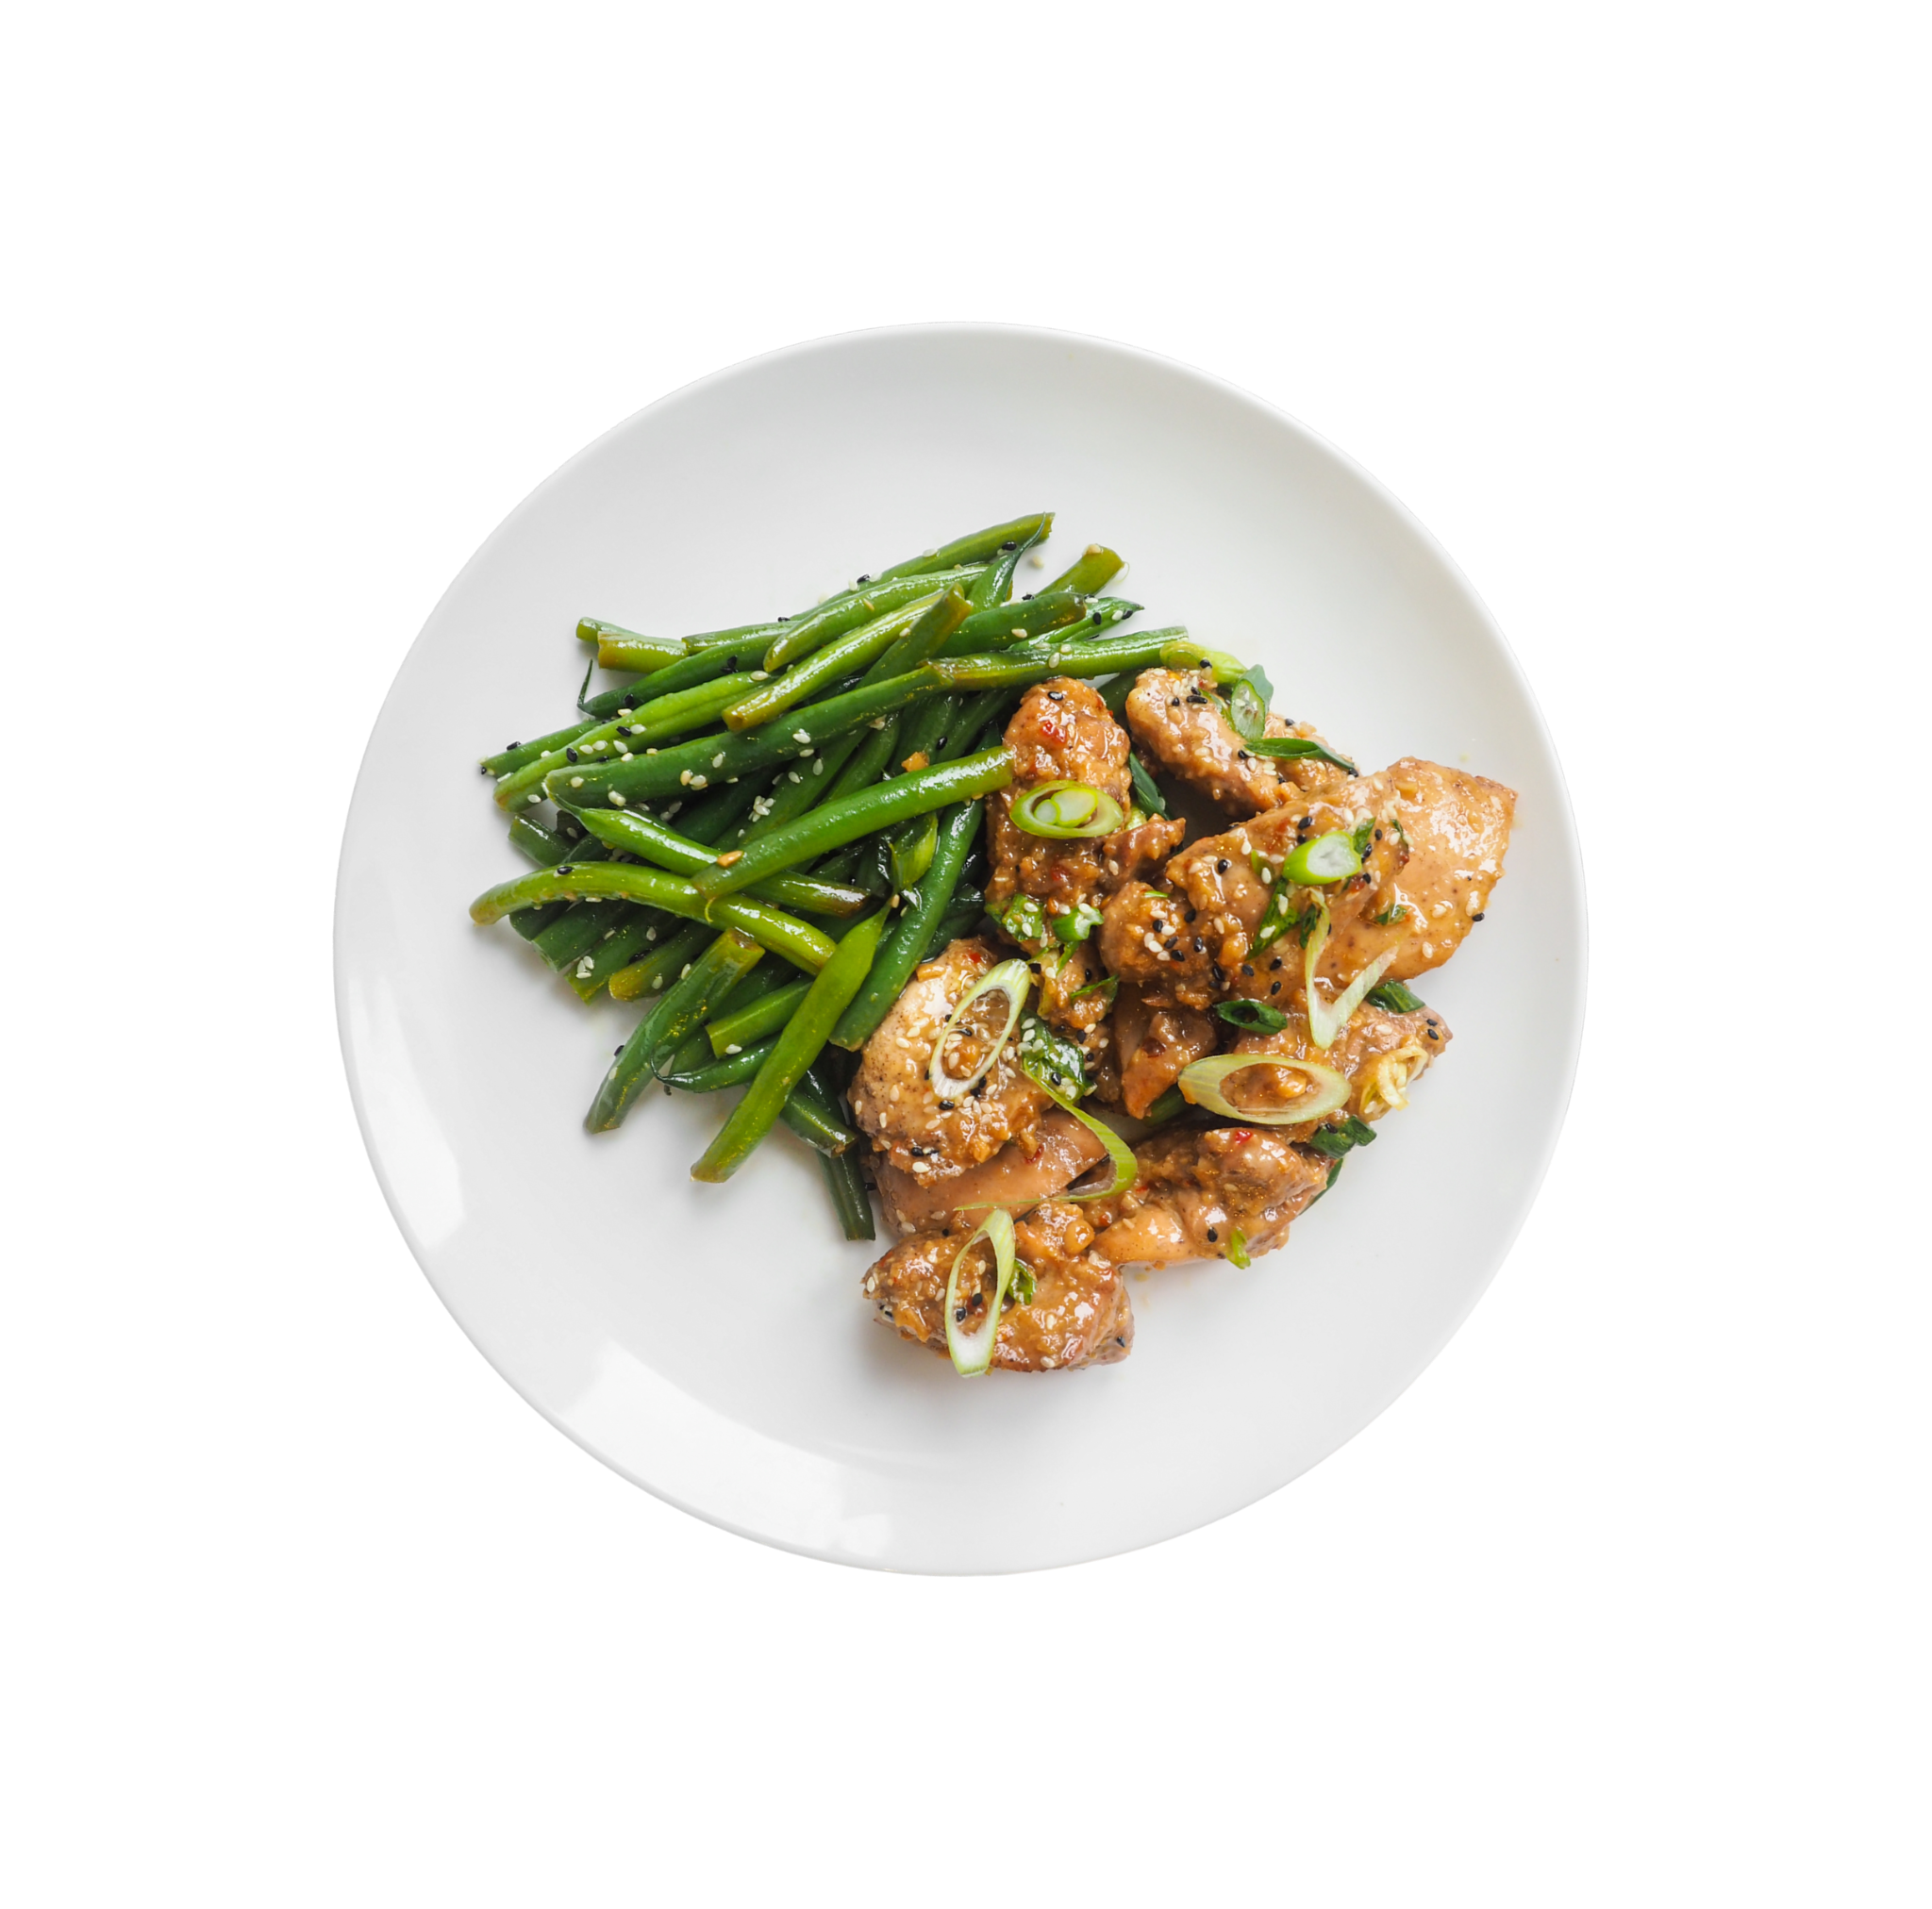

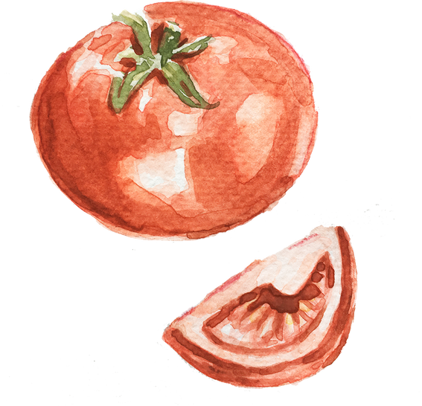

CookmeAI
Culinary with AI

Slide 2

Project Overview
CookmeAI is an AI-powered web application designed to assist users with cooking related queries.
Key Features:
Instantaneous response to cooking questions
Concise summaries of preparation steps
User-friendly interface powered by Streamlit

Slide 3



Use Case Scenario

Slide 4






THE BUSY PROFESSIONAL
She visits CookmeAI and inputs her cooking query.
Emma, a busy professional, wants to cook dinner but has limited time for meal preparation.
CookmeAI instantly provides concise cooking instructions, enabling Emma to quickly prepare a delicious meal without spending excessive time in the kitchen.

Slide 5
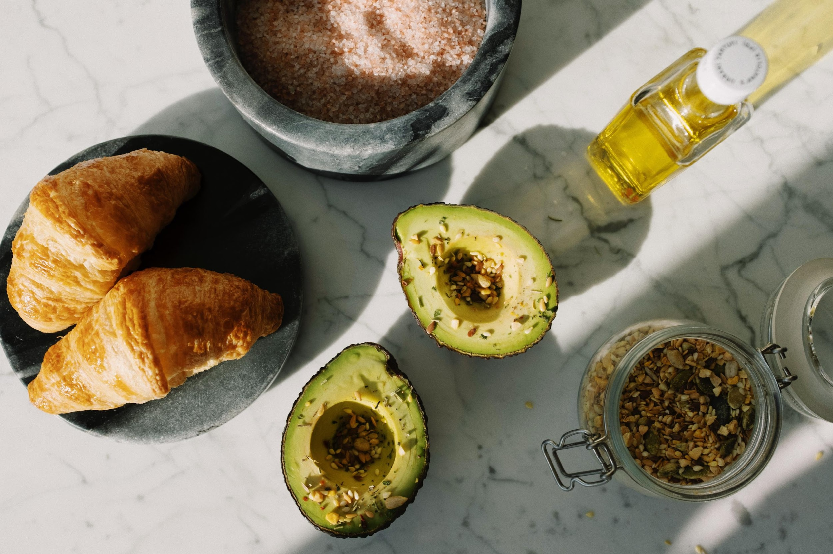
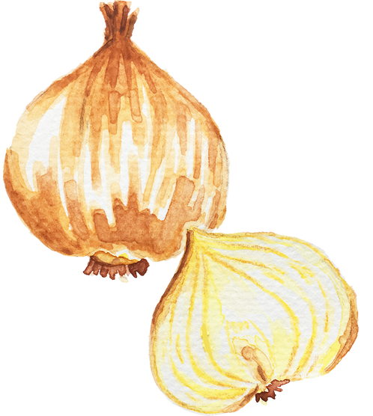

WORKFLOW
.

Slide 6
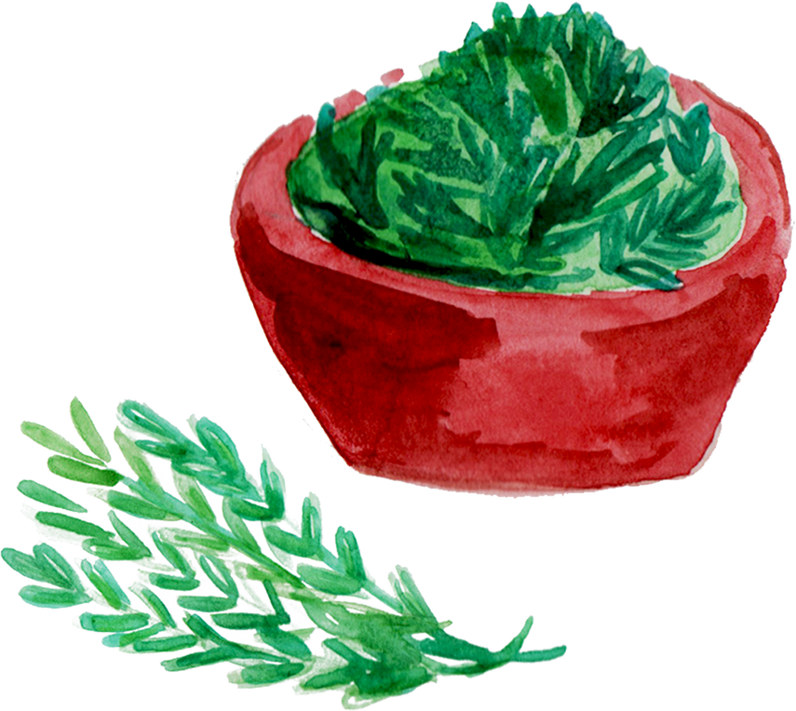
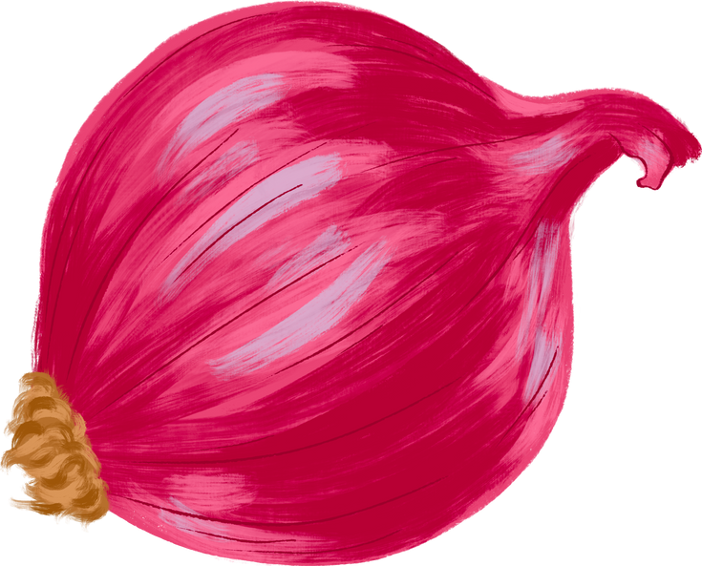
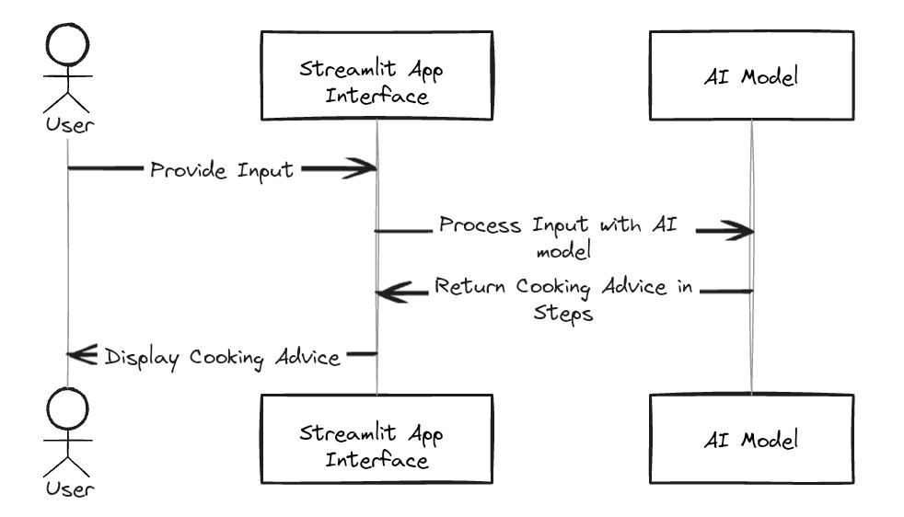

“
CookmeAI

Slide 7


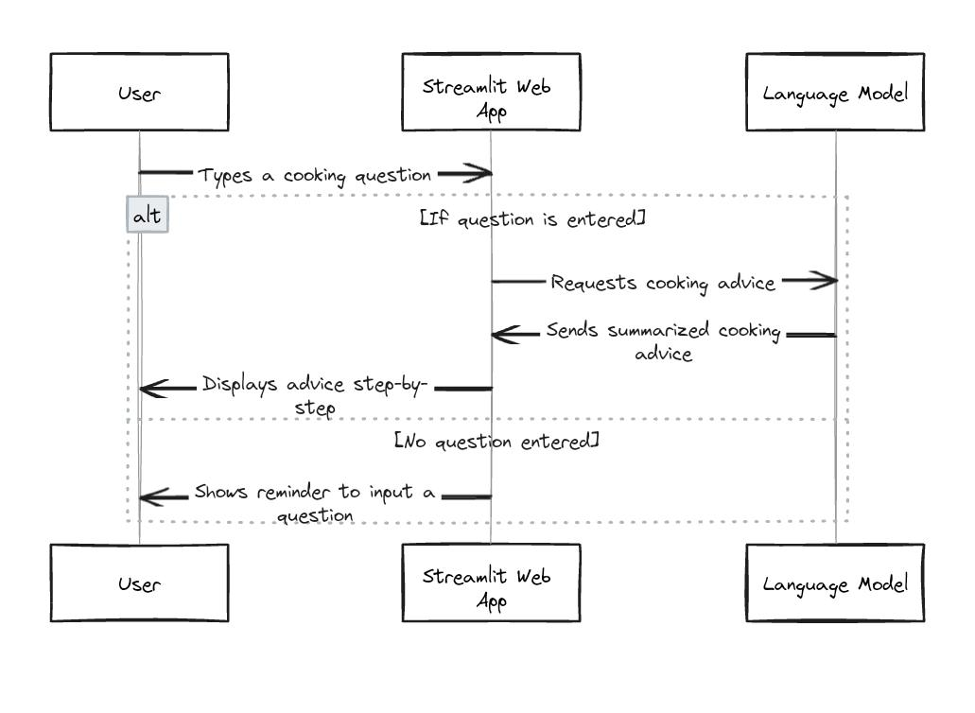
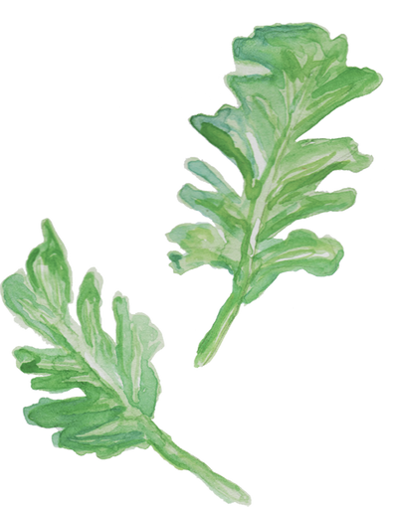


Slide 8
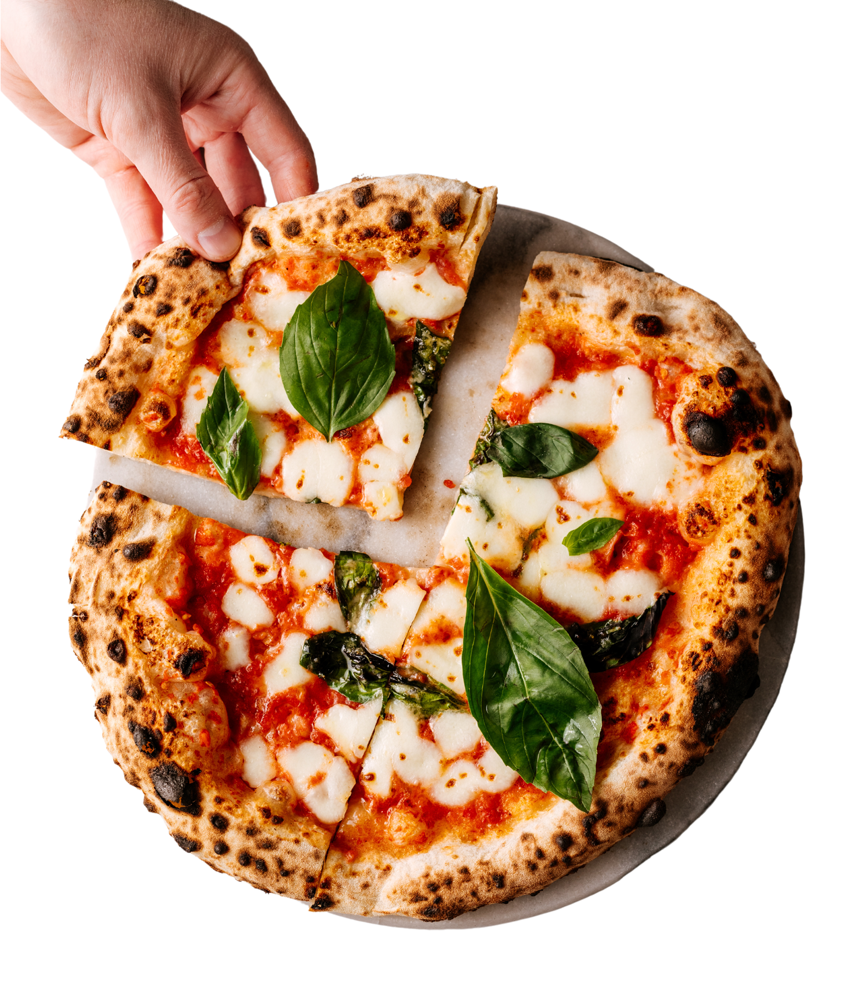
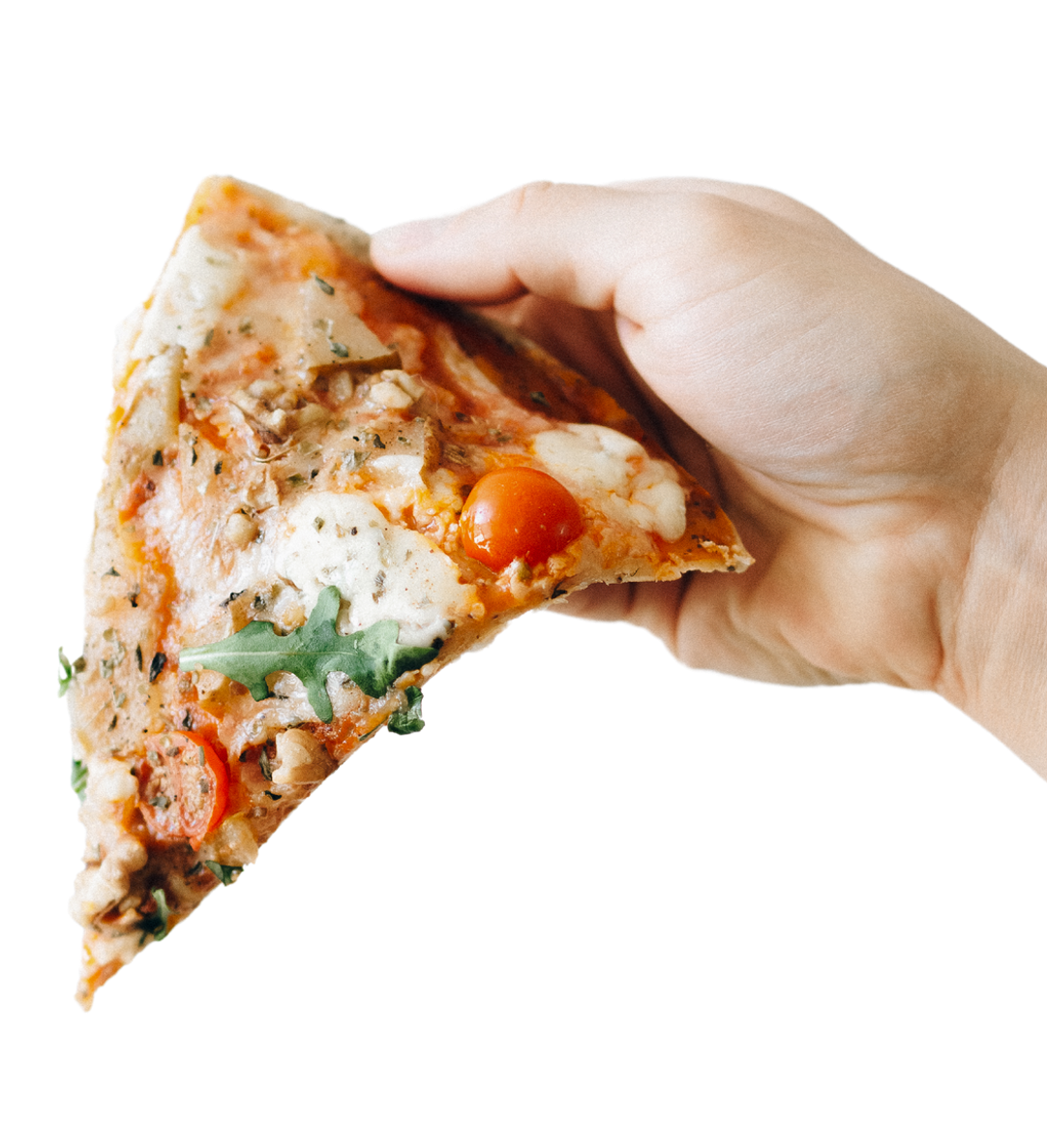



CookmeAI
CookmeAI leverages AI technology to simplify the cooking process for users of all skill levels.

Slide 9



CREDITS
Harichselvam-211191101045

